Slide 1
Xamarin Android
How to setup a project
Unkyu Lee
3 / 15 / 2018

Slide 2
What you’d get to know:
Create Xamarin android project in Visual Studio 2017
Setup MVVM
Using local SQLite database
Take away with project sample

Slide 3
AB
A. View
B. Resources
E. Local DB
CE
AC
F. REST Services
CF
C. ViewModel

Slide 4
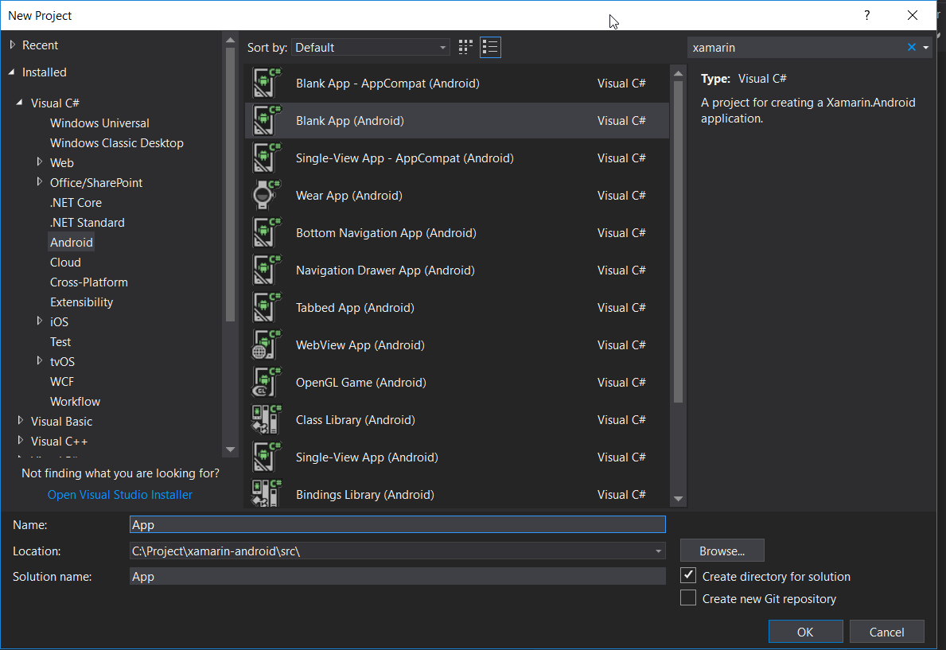
Creating Visual Studio Project
New Project
Visual C#
Android
Blank App (Android)
Assumptions
- Android SDK and emulator is installed and setup

Slide 5
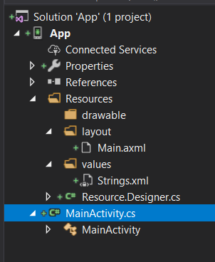
Delete those
GettingStarted.Xamarin
Assets
Resources/mipmap*
Resources/AboutResources.txt

Slide 6
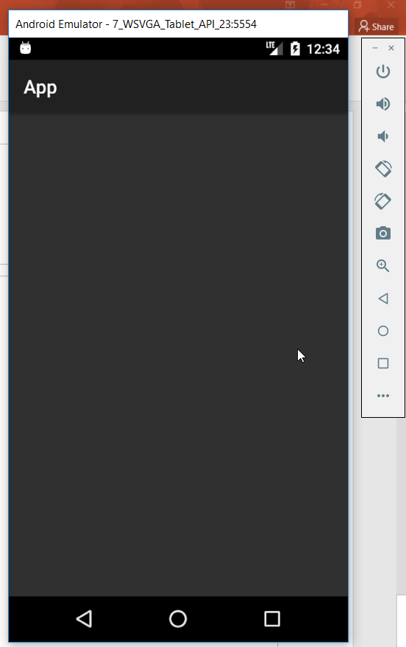
Compile then running the project should get you here. If not, stackoverflow will be there for you

Slide 7



Essential Nuget Packages
sqlite-net-pcl
PCLStorage
Xamarin.Android.Support.Design
MvvmCross.Droid.Support.V7.AppCompat

Slide 8

Setup MvvmCross
Install Nuget Package:
MvvmCross
https://github.com/MvvmCross/MvvmCross
Create file “LinkerPleaseInclude.cs”
This file is for the release version
To solve: compiler won’t be able to link necessary objeect due to implicit architecture of MvvmCross
Create file “Setup.cs” and “App.cs”
This is where dependency injection is configured

Slide 9
After this point, we should be able to focus on writing code rather than project configuration

Slide 10
MVVM - Model – View – ViewModel
Model: represents data
View: represents presentation layer
ViewModel
Enables Model changes are notified to View
Enables View changes are notified to Model
Compare to MVC
MVC fits well in request/response architecture (Web)
MVC fits well in shorter life-cycle instances
IMO, difference is that MVVM notifies data changes between View and Model to each other.
Whereas MVC is one way, either Model -> View or View -> Model in a given life-cycle

Slide 11
Dependency Injection
It is a design pattern which goes very well with MVVM
Encourages disconnection between implementations
In MvvmCross
ViewModels are injected through dependency injection
Meaning, no explicit instantiation of any ViewModel is necessary
new xxxViewModel() ← never happens, and not necessary
Very useful – as you don’t have to manage the life-cycle of those objects

Slide 12
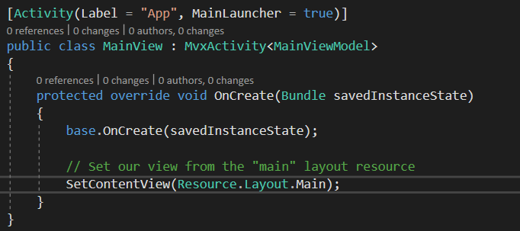
View codes
MainView will be using MainViewModel
MainView loads Main.axml layout

Slide 13
That’s all for the view most of the cases you will be writing your code in the ViewModel and the View layout

Slide 14
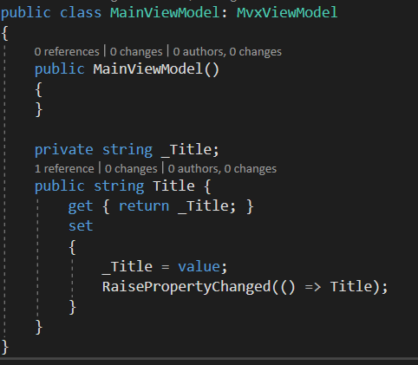
ViewModel codes
Inherits MvxViewModel for 2 reason
To use the MvvmCross utilities
To be automatically injected to the View
Properties that will be used in the View

Slide 15
Note that ViewModel - Is a plain class - Not aware of the view this is quite a big advantage in terms of architecture. it is unit test-able In other words, no need to have view in order to compile. Can be in a separate dll with 0 reference to the view

Slide 16
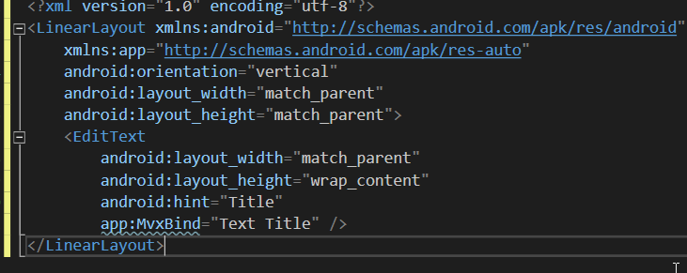
Layout Code
Make sure namespace is included
ViewModel binding goes here “app:MvxBind”

Slide 17
Put break points in ViewModel and see how they interact each other Note that whatever binding suggested in the layout does not prevent from compiling the code, neither crashes at runtime

